Slide 1


Slide 2

Session 5. Data scraping

Slide 3
Session 5. Data scraping
Scraping the HTML source

Slide 4
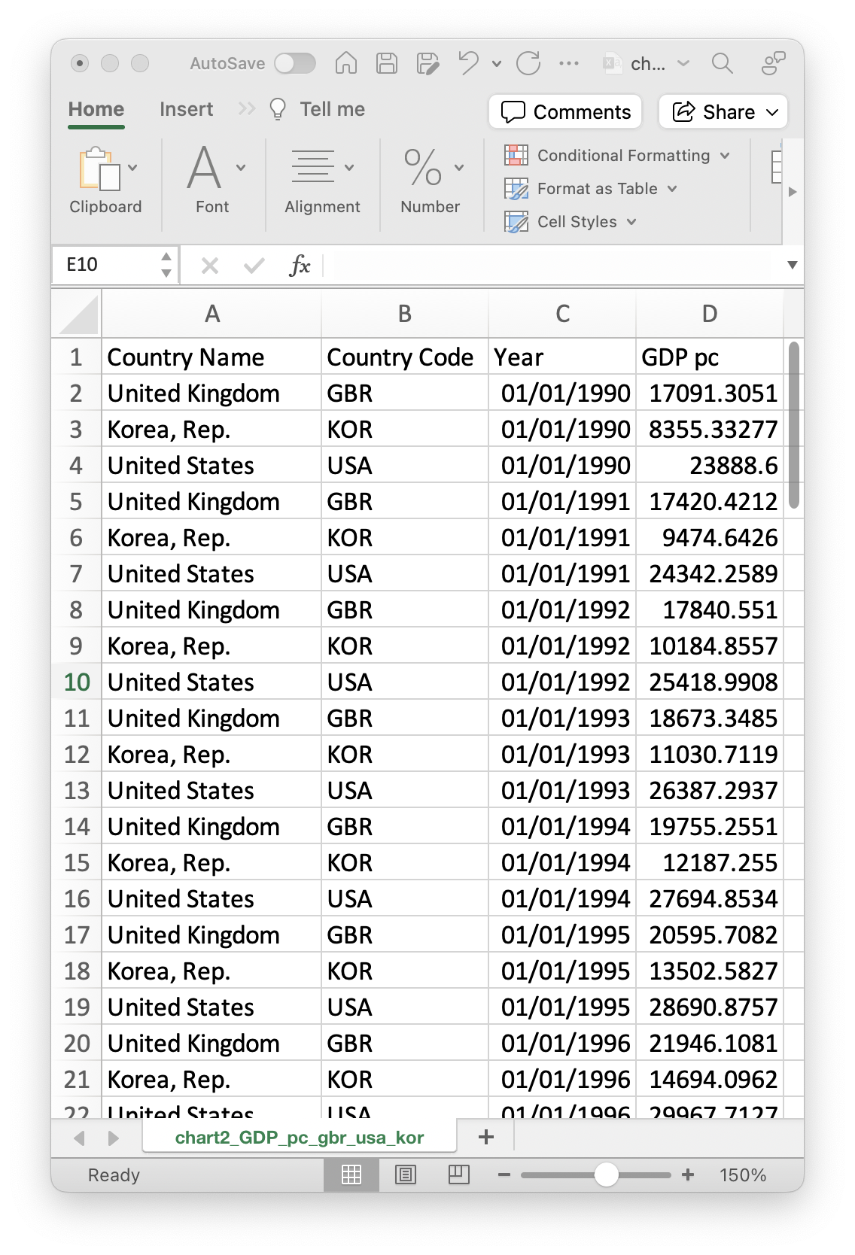
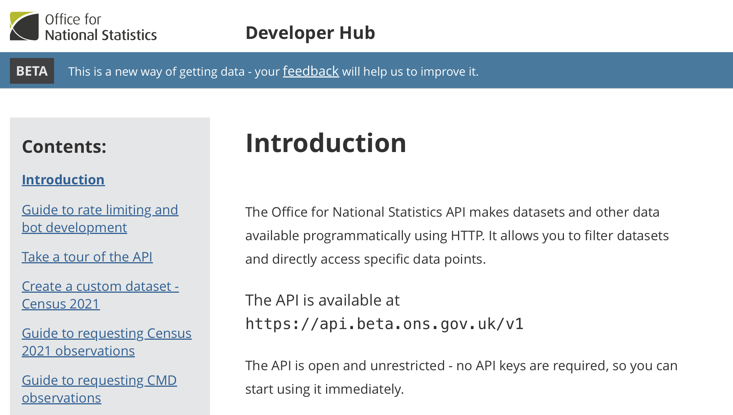
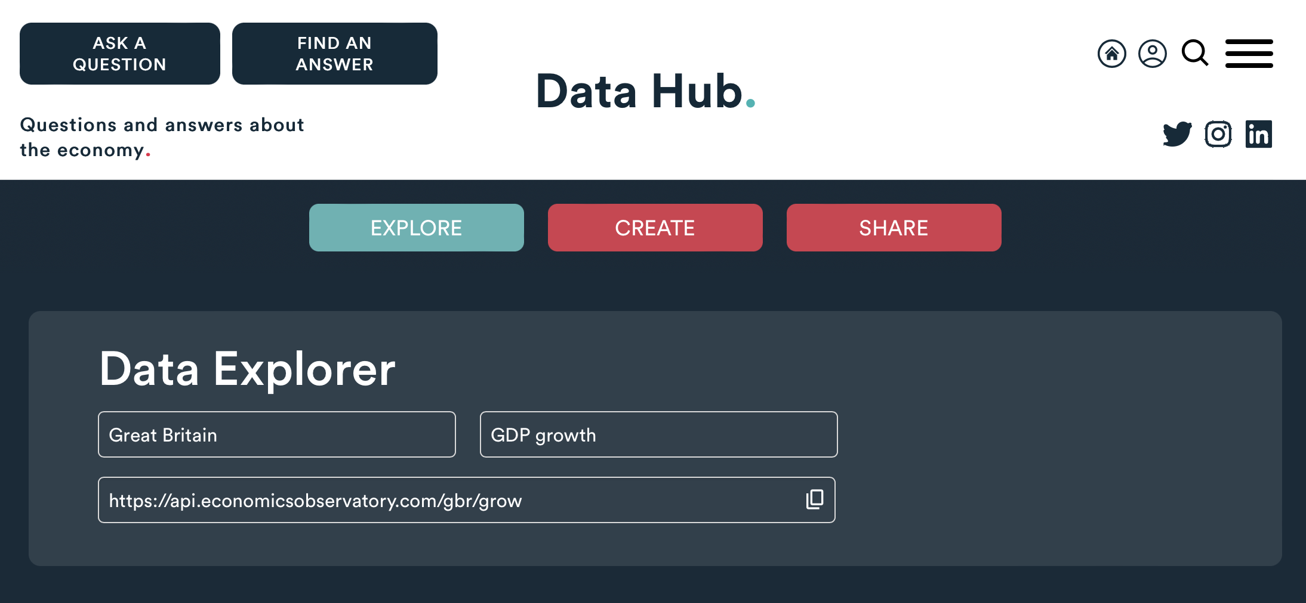
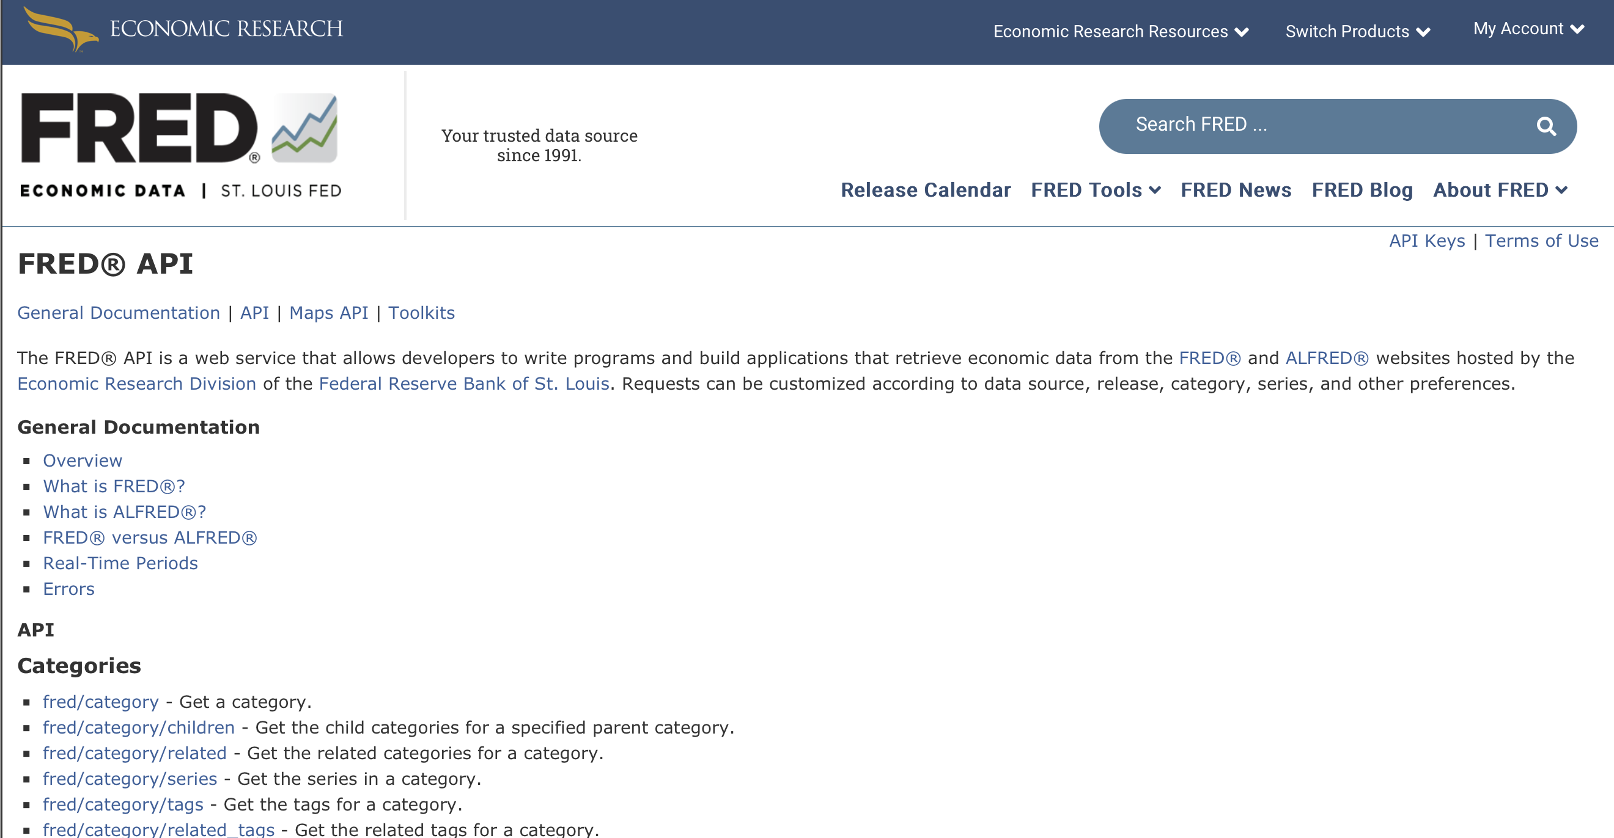
Data, so far...
Today we have used data from
Structured Files
(e.g. Excel, CSV, JSON)
APIs
(e.g. ONS, ECO, FRED)
But what do we do when the data we want isn’t available?

Slide 5
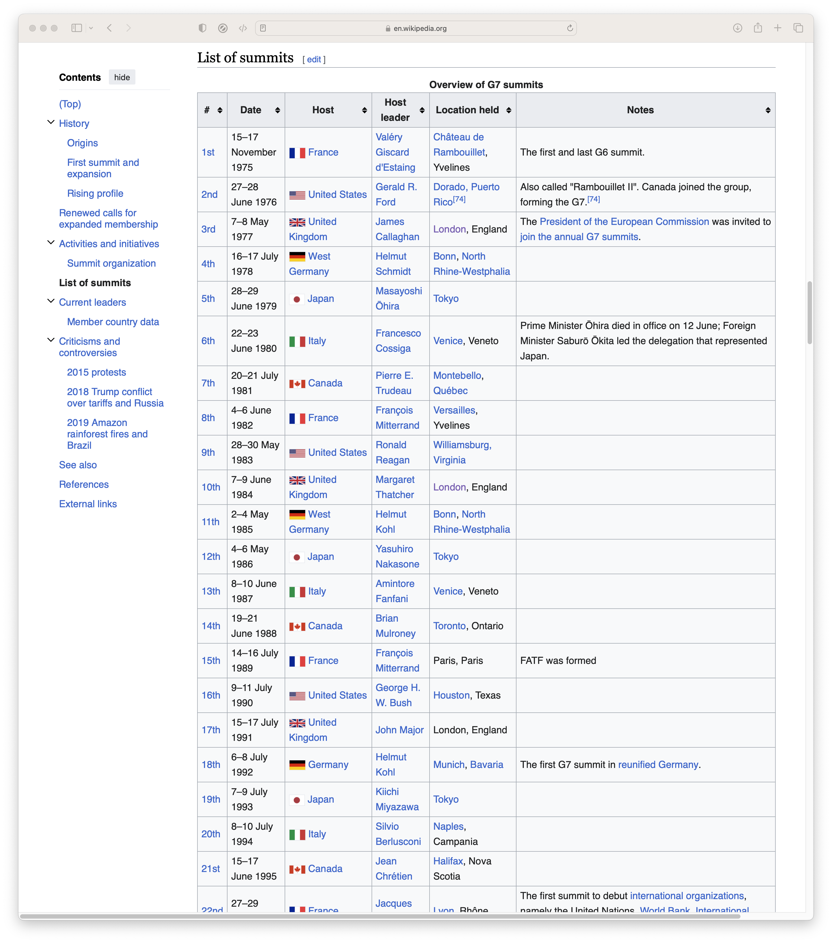
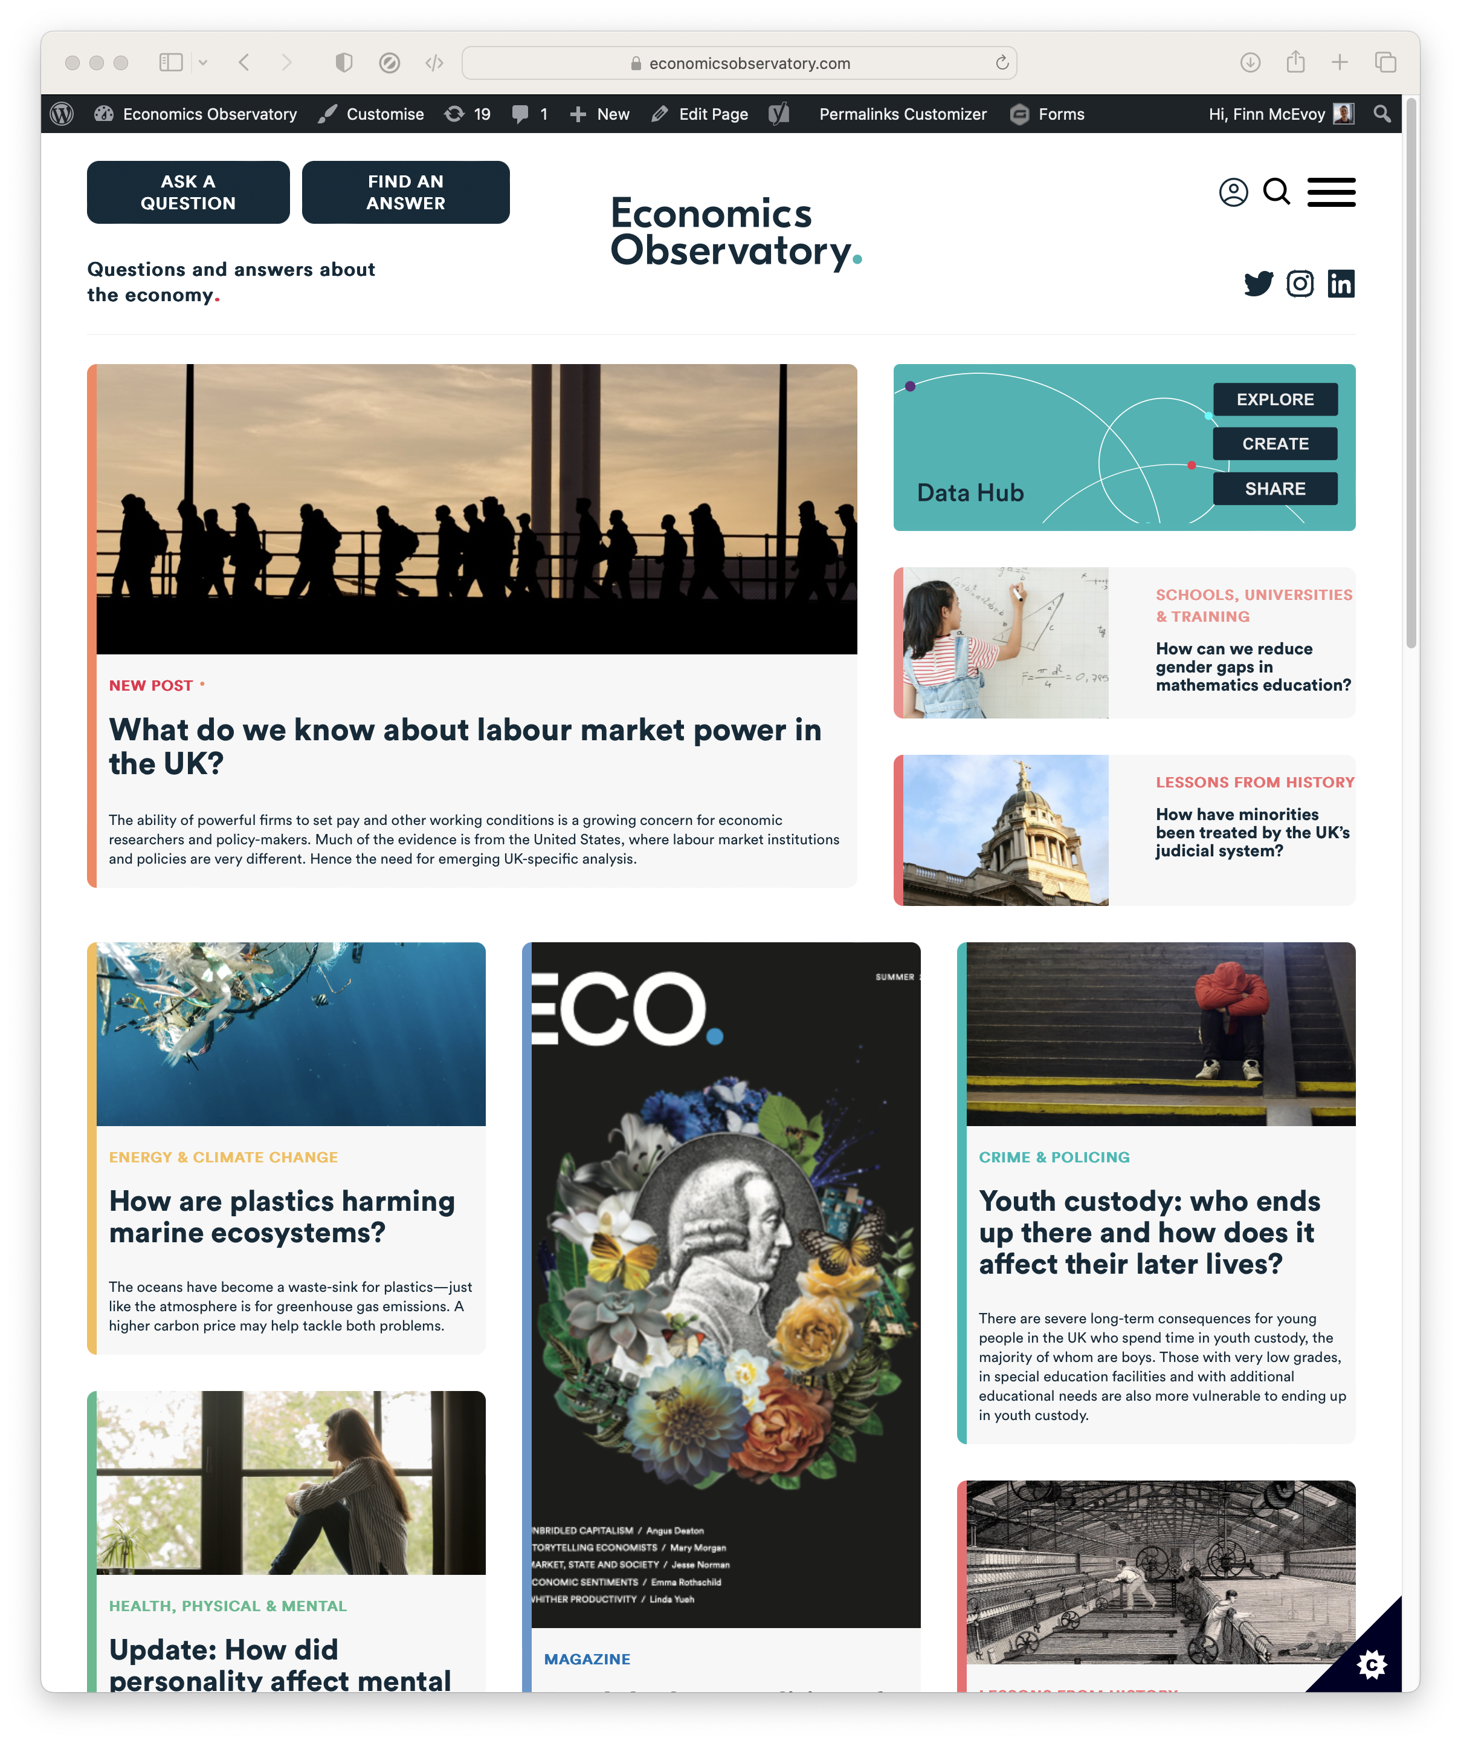
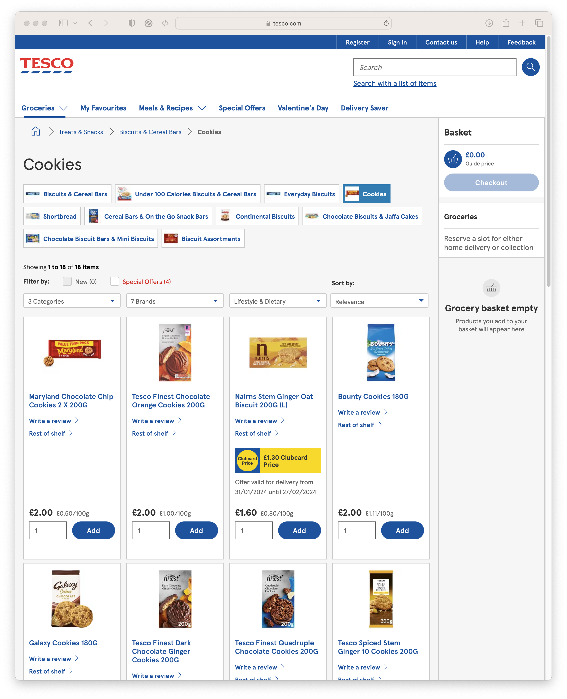
Data, so far...
What if we want
Data from Wikipedia
News and Media
Prices from Supermarkets

Slide 6
Scraping.
The automated extraction of data from websites
Scraping the HTML source. Easy. Automated.
Scraping static HTML pages.
A bit more difficult. Can be automated.
CAPTCHA. Impersonating a human user. Zombie browser.
Scraping HTML pages generated on-the-fly with JavaScript.
Hard. Only zombie browser works, and only in some cases.
hiQ labs vs. LinkedIn, 2019, US Court of Appeals for the Ninth Circuit, 17-16783
LinkedIn vs. hiQ labs, 2021, US Supreme Court, 19-1116

Slide 7
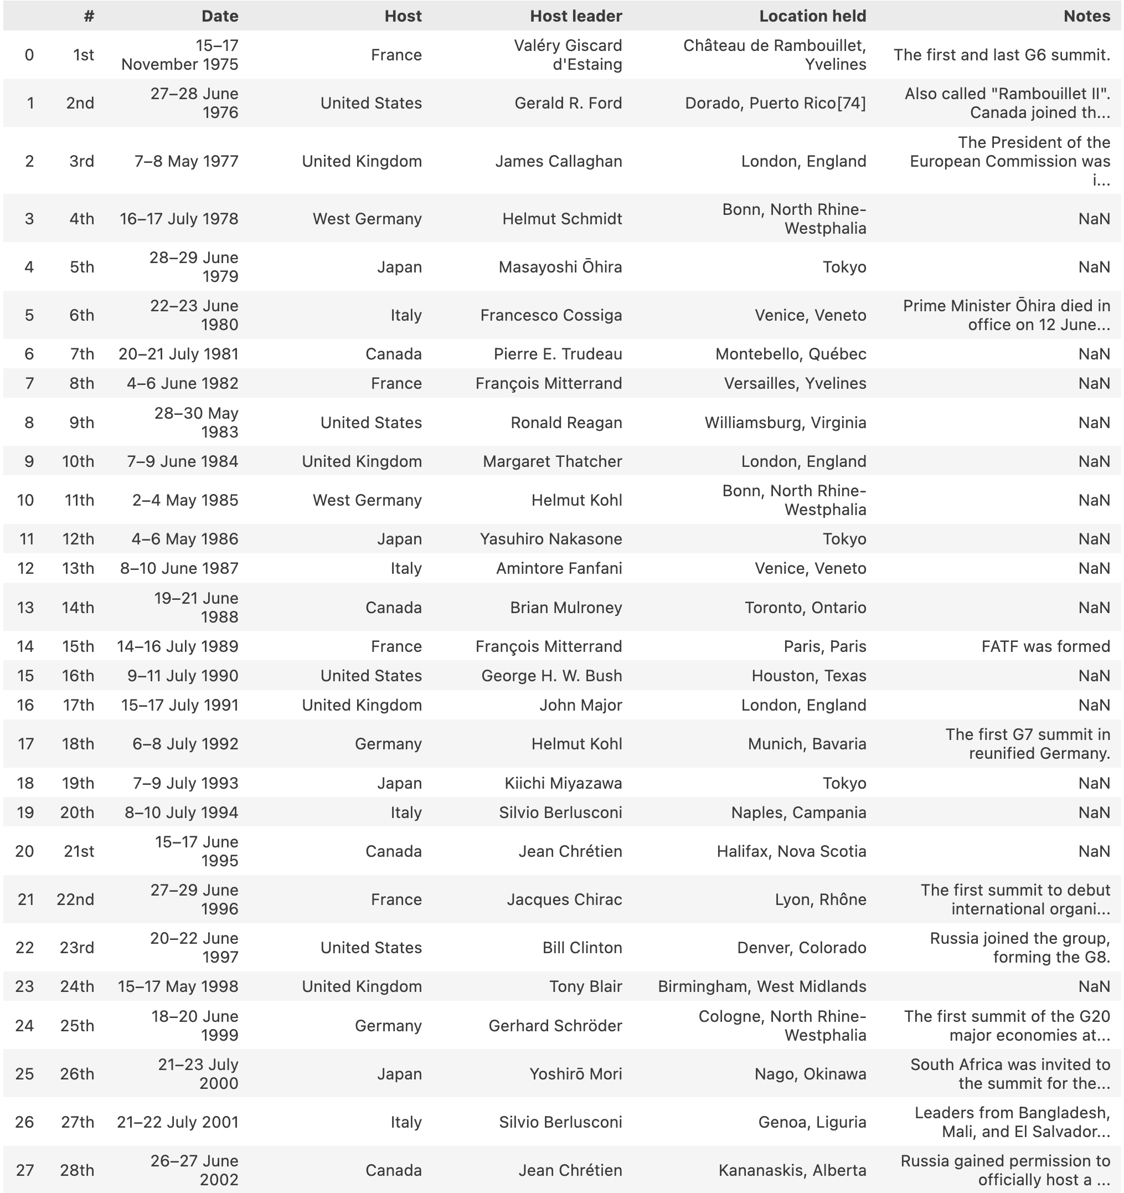
Your first scraper.
1. Extract data from Wikipedia
Notes:
We’re primarily going to scrape Wikipedia today

Slide 8
Your first scraper.
2. Take a quick look at more complicated scraping
3. Share the tools to learn more
Notes:
But you’ll also leave with a demonstration of tools you can use to learn more.
Today intended to spark an interest.

Slide 9
Overview.
1. Identify the data needed
2. Look Around – do you need to scrape?
3. Scrape the data
4. Cleaning and Visualising

Slide 10
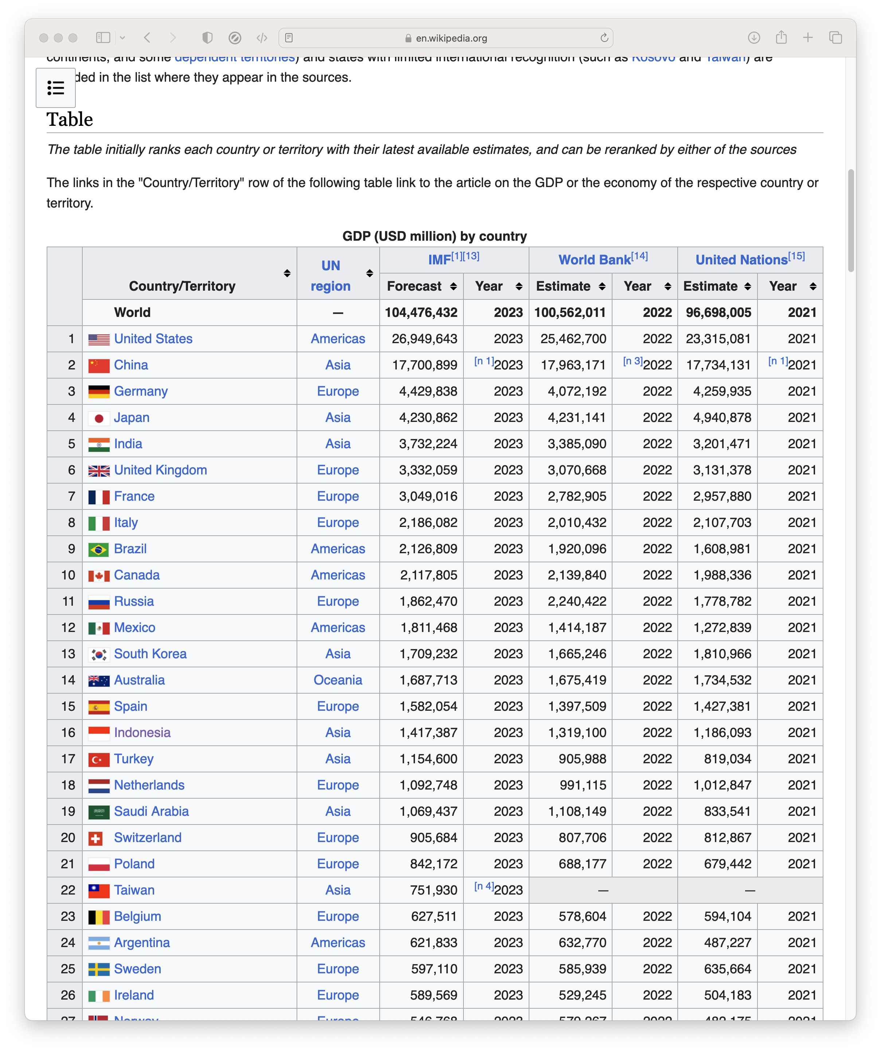
Identify the data needed.
You can scrape almost anything
… but scraping is most useful for hard-to-find data
You could scrape Wikipedia’s list of countries by GDP…

Slide 11
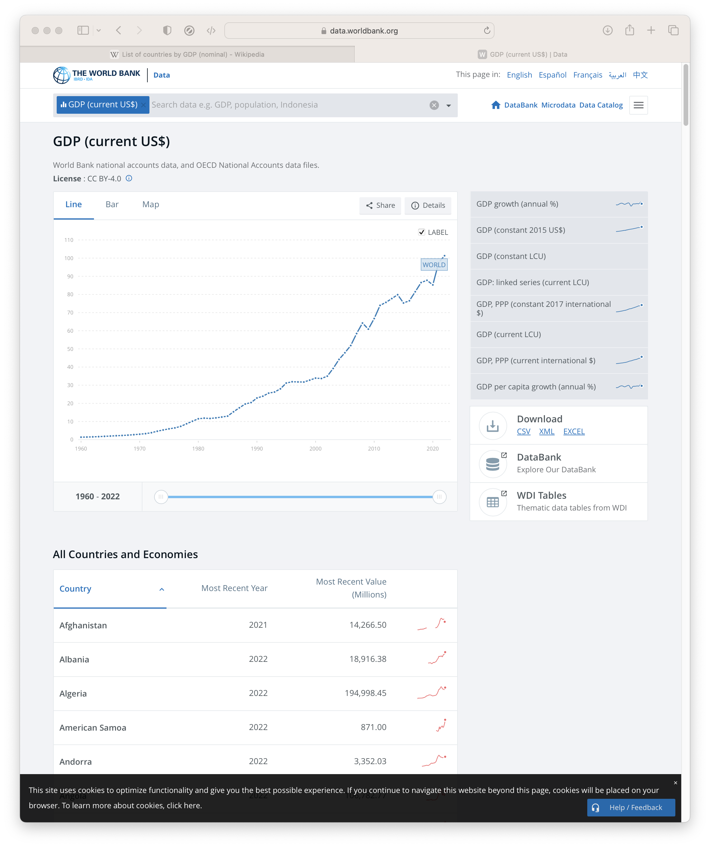
Identify the data needed.
You can scrape almost anything
… but scraping is most useful for hard-to-find data
You could scrape Wikipedia’s list of countries by GDP…
… but there’s no point
If you can just download the data

Slide 12
Look around.
Search the web for exactly the data you want
Try to find a download first
Our Example
Table of G7 Meetings
✓ Excel/CSV Unavailable
✓ Table Available

Slide 13
Scrape the data.
Scraping data from tables on webpages is easy with Python
We can use Pandas, which we have already seen today
pd.read_html(url)
(Loads every table from a webpage)

Slide 14
Scrape the data.
To read all the tables, we point url to our example page
url = "https://en.wikipedia.org/wiki/G7"
tables_from_webpage = pd.read_html(url)
Which makes a list of every table.

Slide 15
Session 5. Data scraping
Scraping the HTML source

Slide 16
Session 5. Data scraping
https://github.com/EconomicsObservatory/courses/blob/main/README.md

Slide 17
Code-along. Your first scraper
In this fifth practical session, we will use Google Colab to use Python to scape data from Wikipedia (and another example if there is time). We will also embed a chart displaying the scraped data into your website, using VS Code and GitHub.
We will run you through the following guided notebook: “Session_5_Scraping_basic.ipynb” (open in Google Colab)
For a further advanced examples, go to: “Session_5_Scraping_advanced.ipynb” (open in Google Colab)

Slide 18
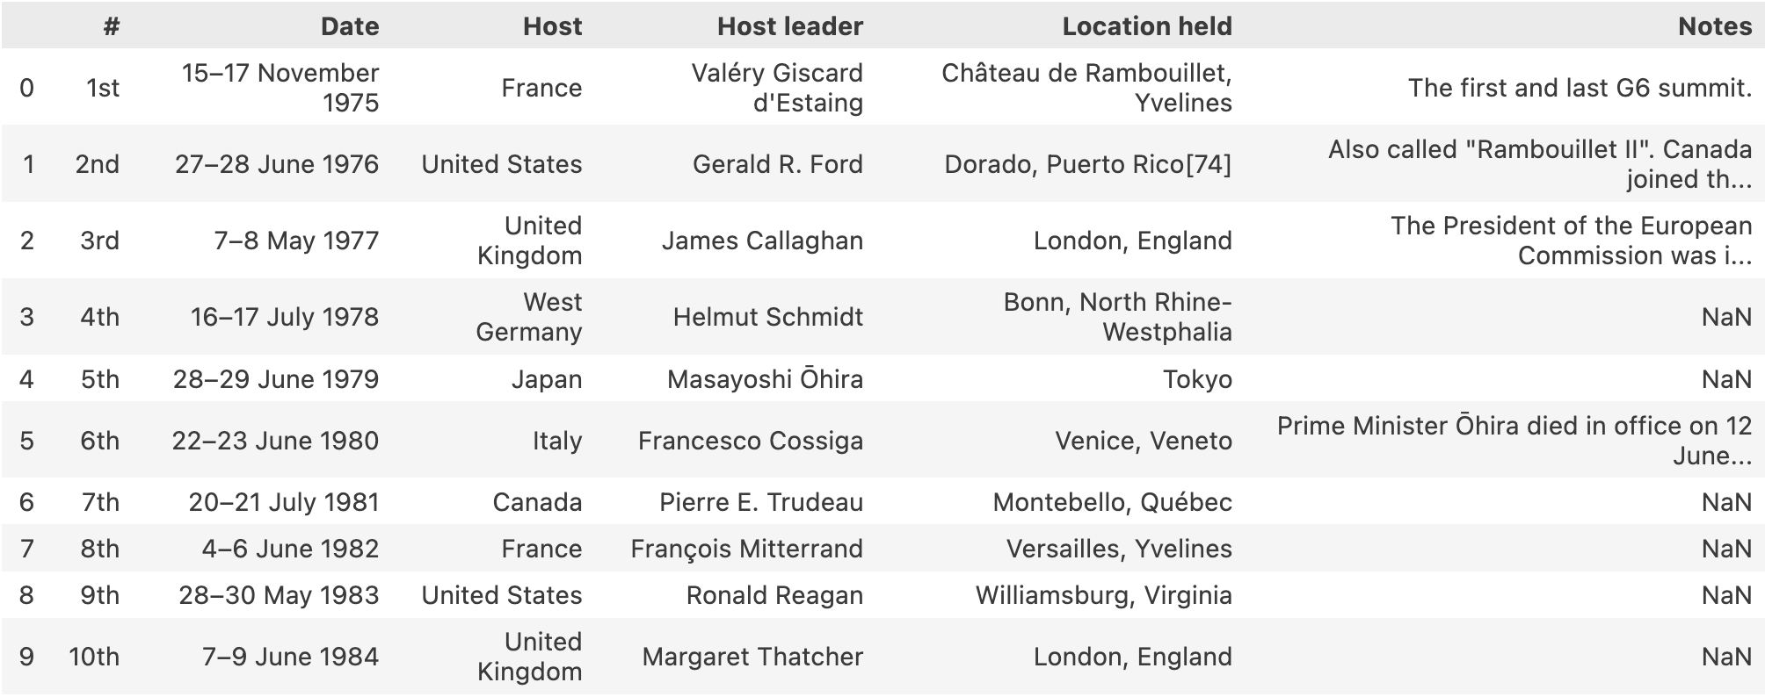
Scrape the data.
The list of G7 meetings, our target, is the 3rd table on the webpage:
tables_from_webpage[2]
Notes:
Reminder: Lists start at 0

Slide 19
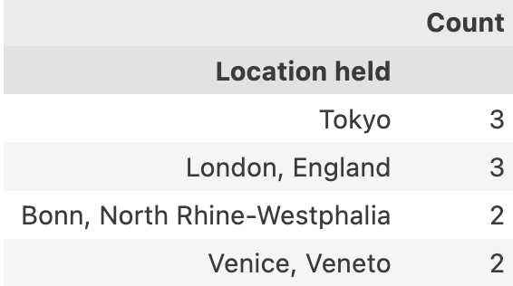
Cleaning and visualising.
We have a messy table of data
Let’s clean it up to answer the following question:
‘What’s the most popular location for G7 meetings?’
(full code in Notebook)
Notes:
Reminder: Lists start at 0

Slide 20
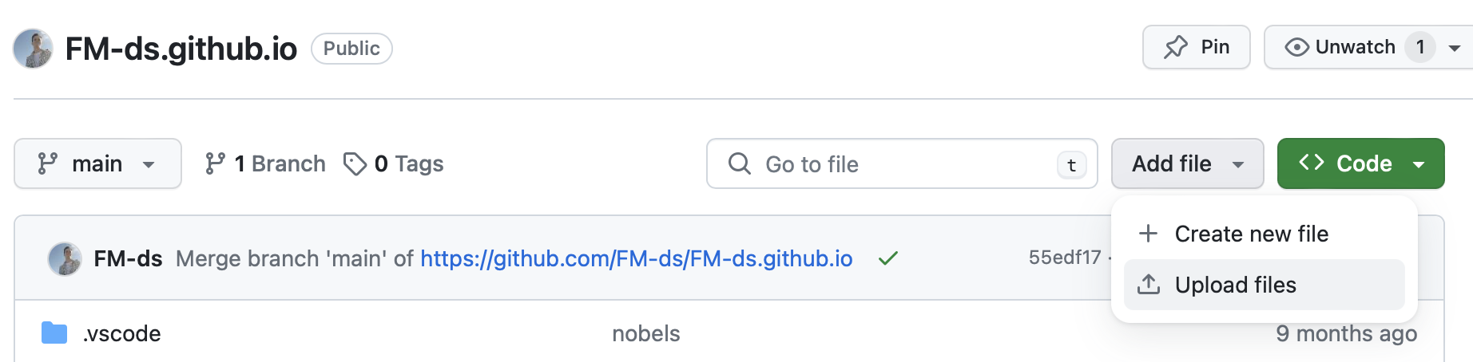
Cleaning and visualising.
After saving our table and uploading to GitHub, we can use it in Vega-Lite
Notes:
Upload the CSV to your github

Slide 21
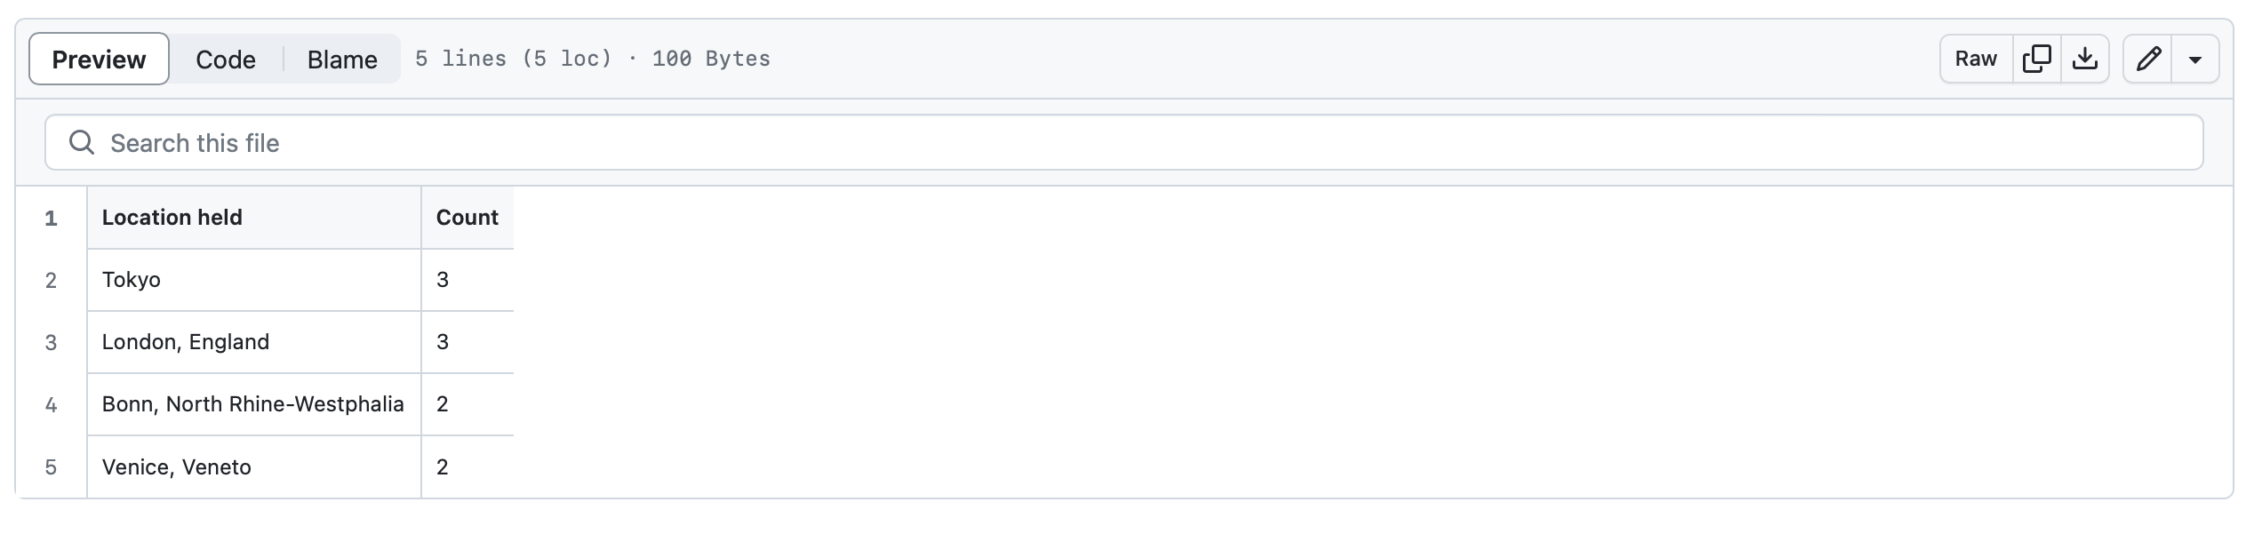
Cleaning and visualising.
After saving our table and uploading to GitHub, we can use it in Vega-Lite
Notes:
Find the file and click raw

Slide 22
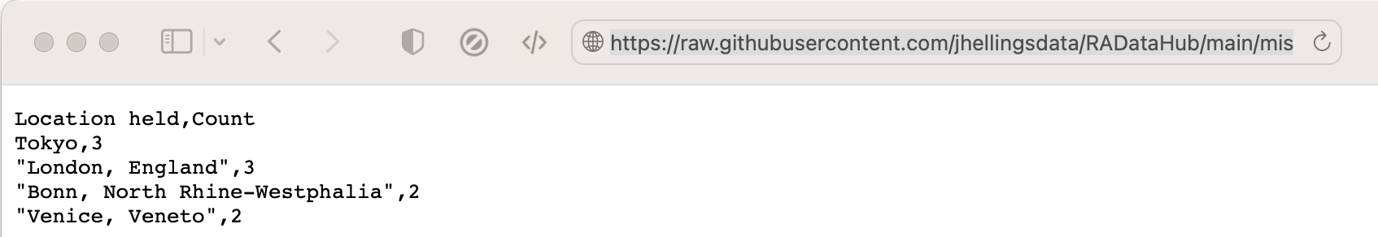
Cleaning and visualising.
After saving our table and uploading to GitHub, we can use it in Vega-Lite
Notes:
Copy the link

Slide 23
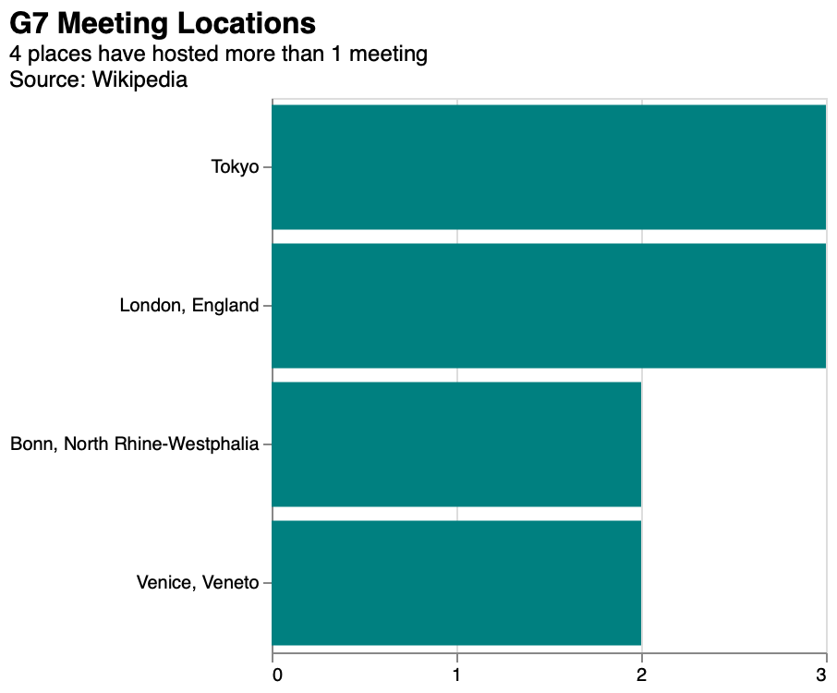
Cleaning and visualising.
Linking to our data, we can use it in a chart:
(see “chart_g7_meeting_hosts.json”)
Notes:
Copy the link

Slide 24
Session 5. Data scraping
Scraping the HTML source (advanced)

Slide 25
Session 5. Data scraping
https://github.com/EconomicsObservatory/courses/blob/main/README.md

Slide 26
Scraping HTML Source.
Scraping tables is easy but sometimes we want data that isn't nicely formatted
Instead, we can extract data by searching the HTML
Everything is defined in the HTML, we just have to find it

Slide 27
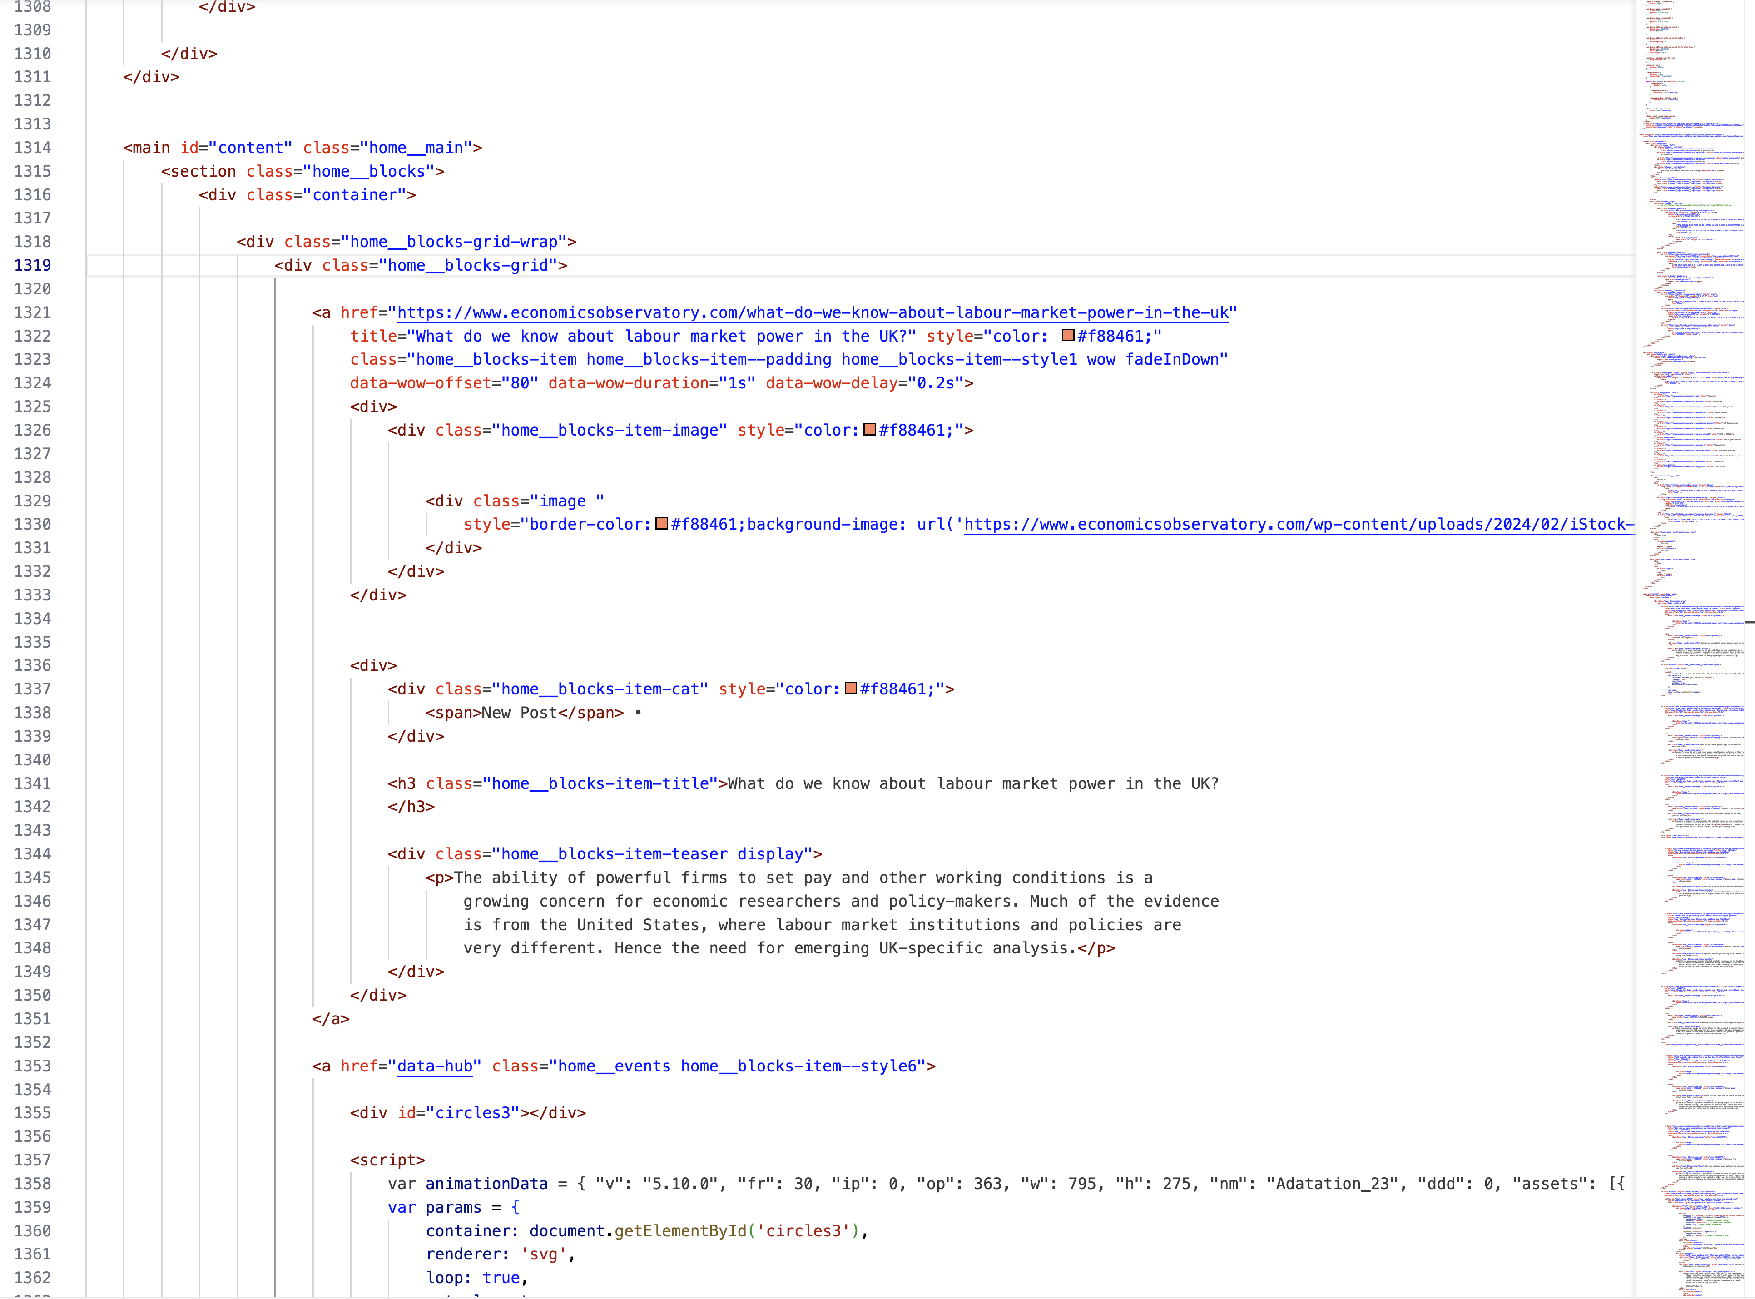
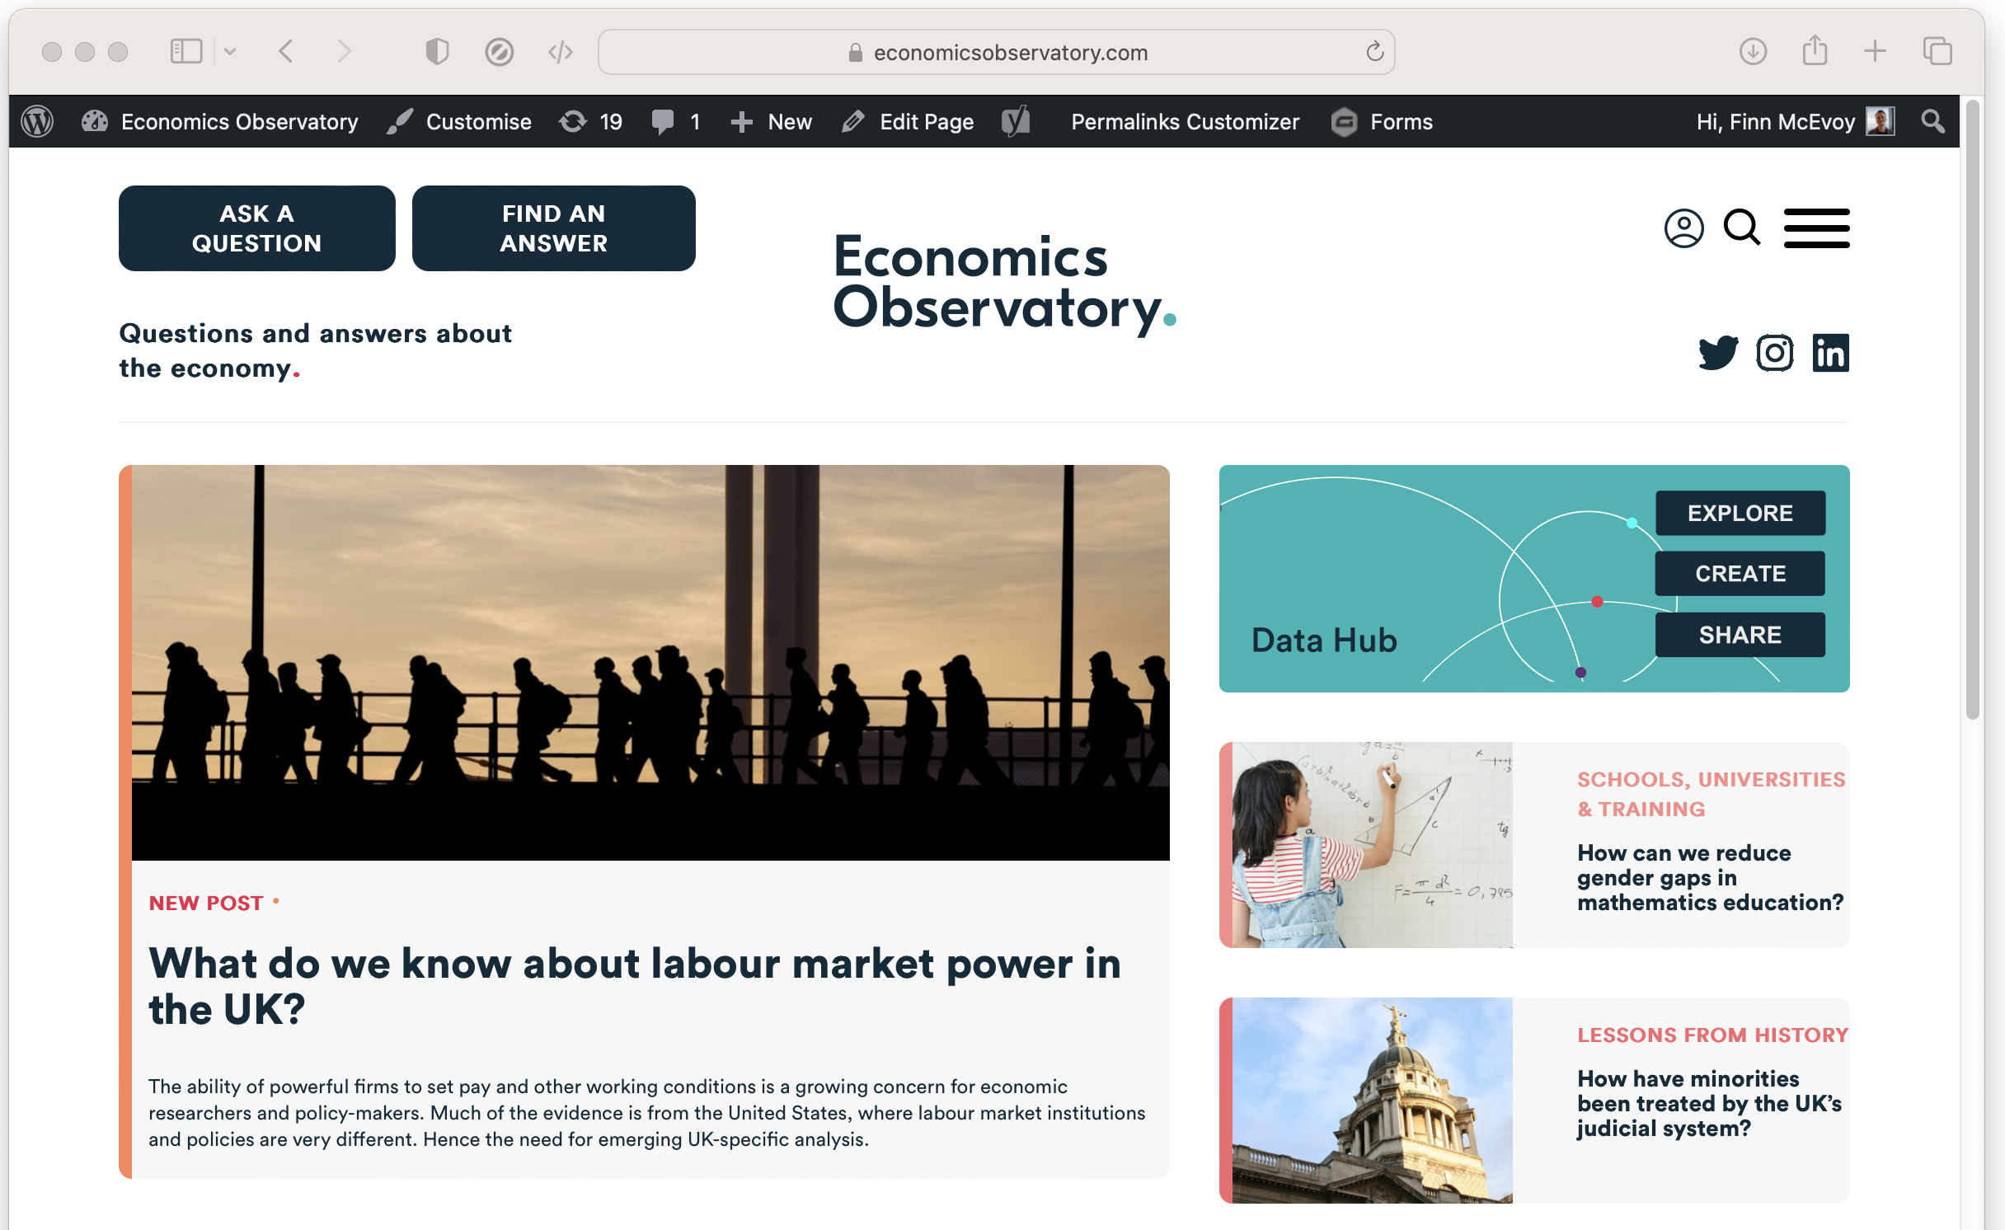
Scraping HTML Source.
For example, we can scrape ECO headlines and tag-lines by ‘parsing’ the HTML
Notes:
On this page, the HTML (2700 lines long!) defines the page we see

Slide 28
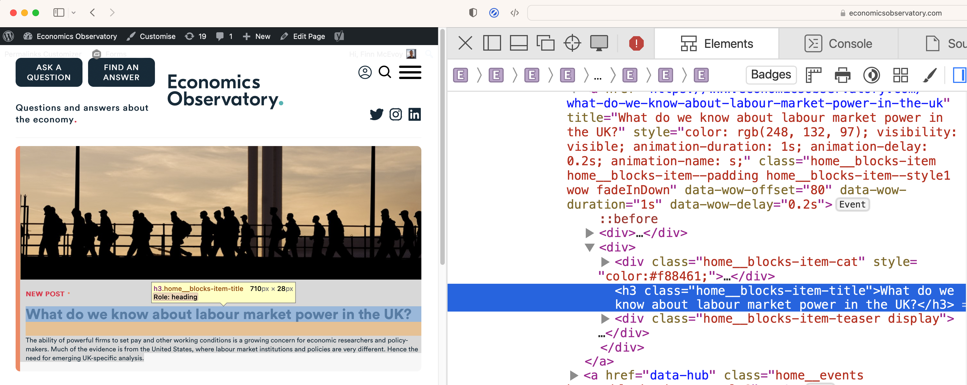
Scraping HTML Source.
We determine how the target data is defined using ‘inspect-element’
We see titles have a class “home_blocks-item-title”
Notes:
On this page, the HTML (2700 lines long!) defines the page we see

Slide 29
Code-along. A more advanced scraper
In this bonus practical session, we will use Google Colab to use scrape data from the Economics Observatory website using Python. Again, we can also embed a chart displaying the scraped data into your website, using VS Code and GitHub.
Work through the following guided notebook: “Session_5_Scraping_advanced.ipynb” (open in Google Colab)

Slide 30
Learn more.
In this session we have tried basic data scraping with Pandas and seen advanced scraping with BeautifulSoup
There’s still much more to learn
Choose your own projects (how can you make your job easier?)
Try bigger projects (scrape 100 pages, not just 1)
Try advanced tools (e.g. Selenium)
Notes:
On this page, the HTML (2700 lines long!) defines the page we see

Slide 31
Learn more, responsibly.
Rate-limiting: avoid making too many requests at once
Ethics: Ensure your scraping activities do not harm the website's operation
Data Privacy: Be mindful of personal data collection. Comply with relevant data protection laws (like GDPR).
Notes:
On this page, the HTML (2700 lines long!) defines the page we see

